Slide 1
AC FUNDAMENTALS
Lecture by:
Sanjna Salim
Division of Electrical Engineering, SoE, CUSAT

Slide 2
Alternating voltage and current equation
Instantaneous voltage
Instantaneous current i=I_{m}sin𝜔t
v=V_{m}sin𝜔t

Slide 3
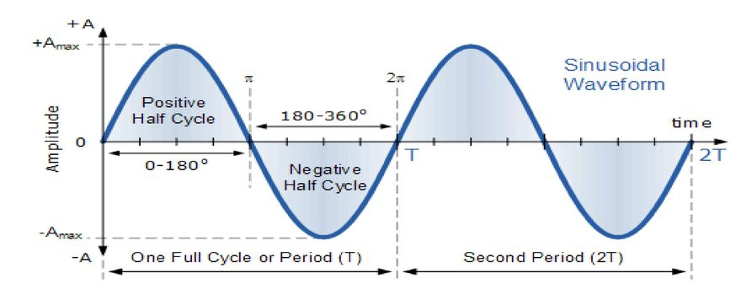
Waveform

Slide 4

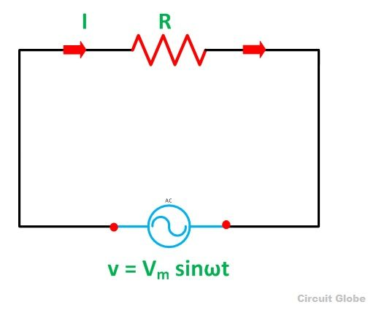


AC through pure resistive circuit(R Circuit)

Slide 5
Reflection Spot 1
Looking at the voltage and current expression, what can you say about the phase difference between them?
How will the waveform and phasor diagram for the circuit look like?

Slide 6
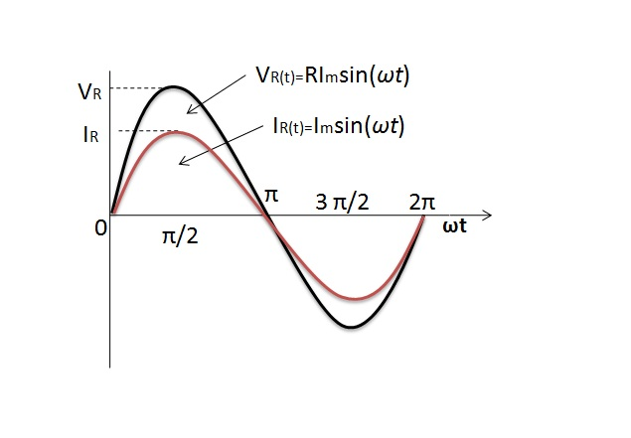
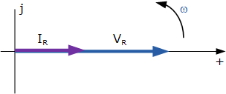
Waveform and Phasor Diagram-R Circuit

Slide 7
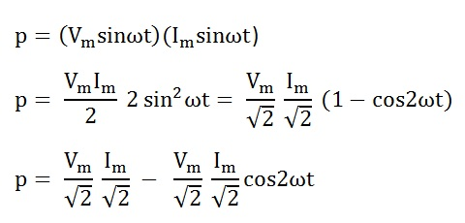
Power
Instantaneous power

Slide 8
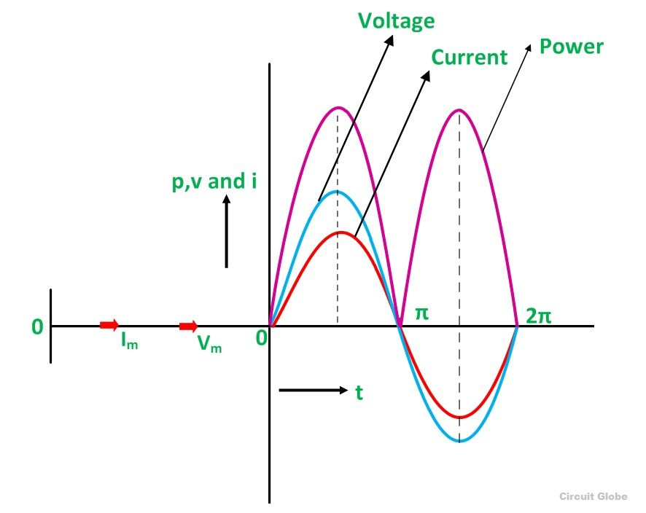
Power-Waveform

Slide 9
Reflection Spot 2
Looking at the waveform in the previous slide what can be said about the average power in the circuit?

Slide 10


Power-R circuit-contd…
Average power

Slide 11
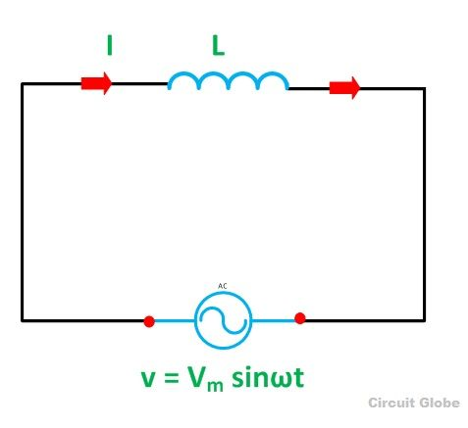


AC through pure inductive circuit

Slide 12
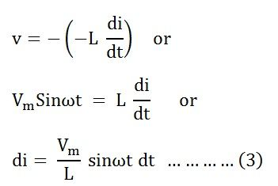
L Circuit- Contd…

Slide 13
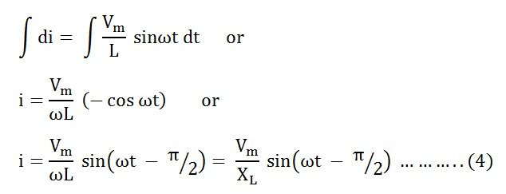
L Circuit-Contd…

Slide 14


L Circuit-Contd…
X_{L} = ωL is the opposition offered to the flow of alternating current by a pure inductance and is called inductive reactance.

Slide 15
Reflection Spot 3
What change has occurred in the voltage and current relationship compared to the previous case?

Slide 16
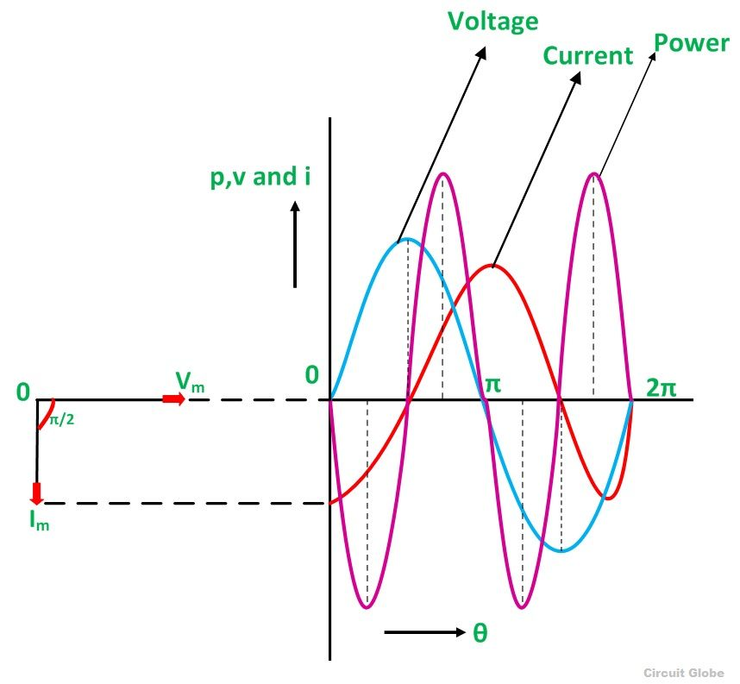
Waveform and phasor diagram

Slide 17
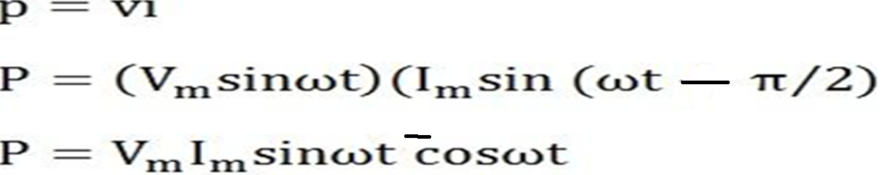
Power-L Circuit
Instantaneous power

Slide 18
Contd…
The average power consumed in a purely inductive circuit is zero.

Slide 19

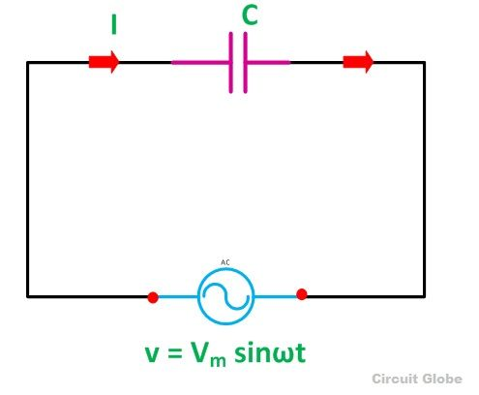


AC through pure capacitive circuit

Slide 20
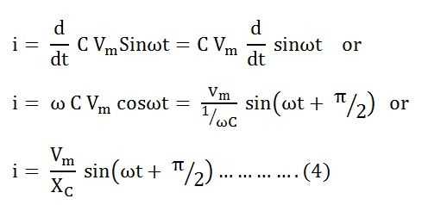
C Circuit-Contd…

Slide 21


C Circuit- Contd…
Xc = 1/ωC is the opposition offered to the flow of alternating current by a pure capacitor and is called Capacitive Reactance.

Slide 22
Reflection spot 4
Compare the current equations in L circuit and C circuit and determine how will the phasor diagram look like for the two cases?

Slide 23
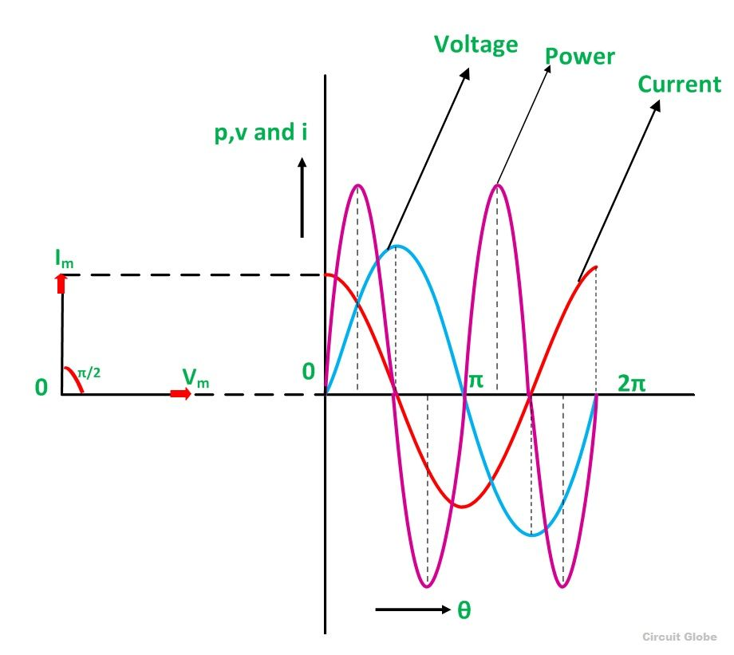
Waveform and Phasor diagram

Slide 24
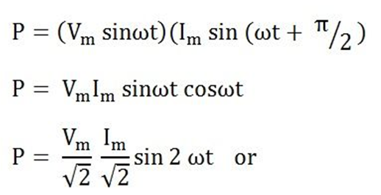
Power-C circuit
Instantaneous power is given by p = vi

Slide 25
Contd…
The average power consumed in a purely capacitive circuit is zero.

Slide 26
Problem 1
A 50 Hz alternating voltage of 150 V(r.m.s) is applied independently to a (i) resistance of 10Ω ii)inductance of 0.2 H iii) capacitance of 50μF. Find the expression for instantaneous current in each case. Draw the phasor diagram

Slide 27
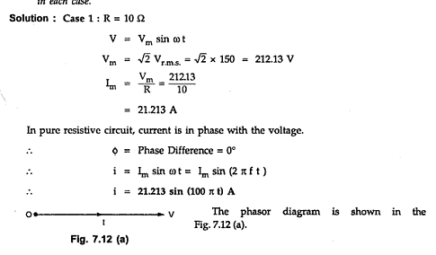

Slide 28
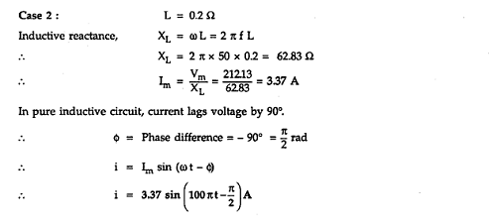

Slide 29
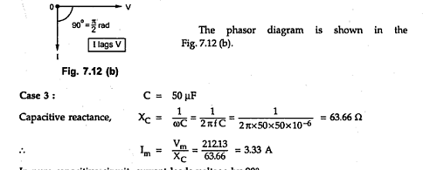
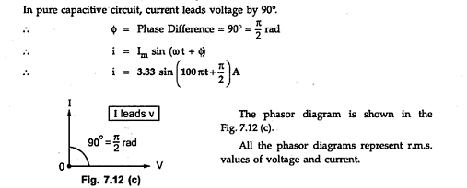

Slide 30
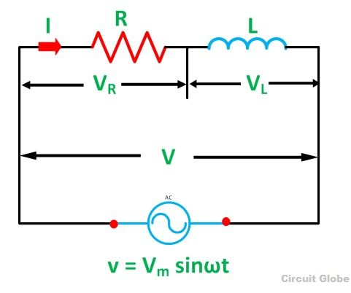
AC through series RL circuit

Slide 31
RL circuit-Contd…
Current I is taken as a reference.
V_{R} = I_{R} is drawn in phase with the current I.
V_{L} =IX_{L} is drawn ahead of the current I.
The vector sum of the two voltages drops V_{R} and V_{L} is equal to the applied voltage V.

Slide 32
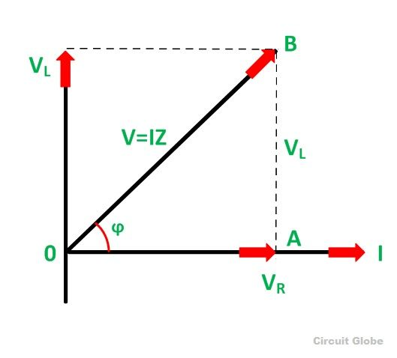
Phasor diagram

Slide 33
Reflection spot 5
Why is current taken as reference in RL circuit?

Slide 34
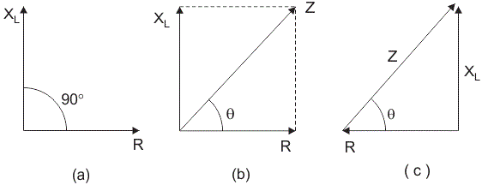
RL circuit- contd…
V_{R} = I_{R} and V_{L} = IX_{L} where X_{L} = 2πfL
Impedance Triangle

Slide 35
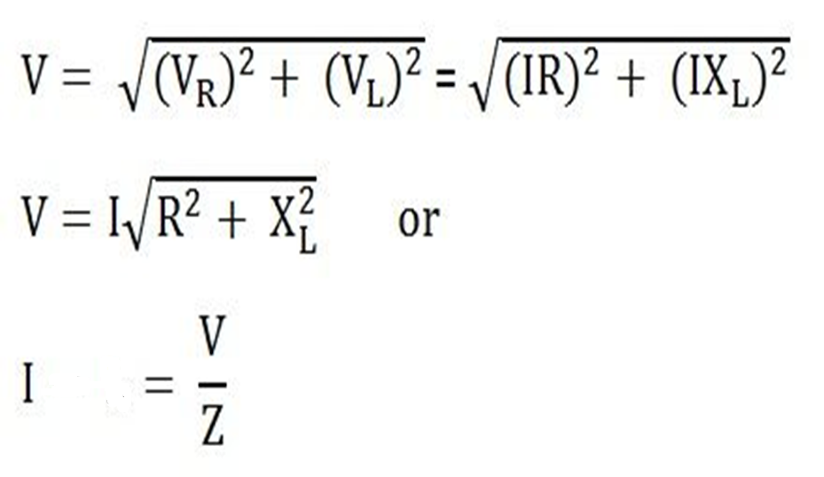

RL circuit Contd…
Z=R+jX_{L}
Impedance
Impedance

Slide 36
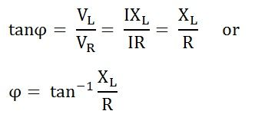
Phase angle-RL circuit

Slide 37

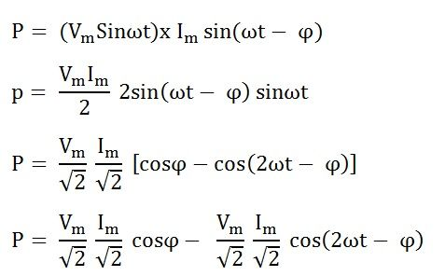
Power in RL circuit
Instantaneous power

Slide 38
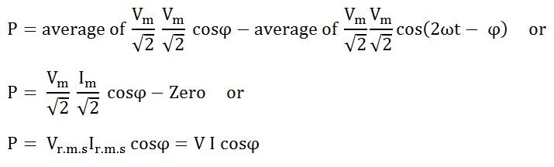
Average Power-RL Circuit
cosϕ is called the power factor of the circuit.

Slide 39

Power Factor

Slide 40
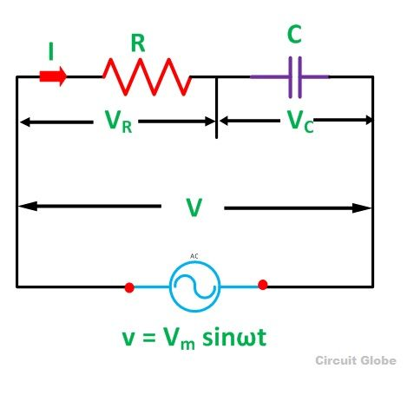
AC through series RC Circuit

Slide 41
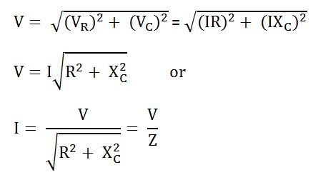

RC Circuit-Contd…
In complex terms Z=R-jXc

Slide 42
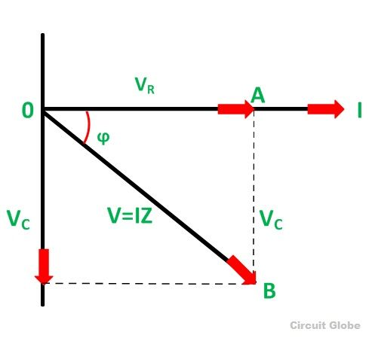
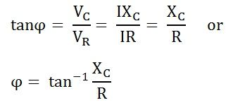
Phase Angle-RC Circuit

Slide 43
Reflection spot 6
From the phasor diagram what will be the expression of current with respect to voltage in RL and RC circuit?

Slide 44
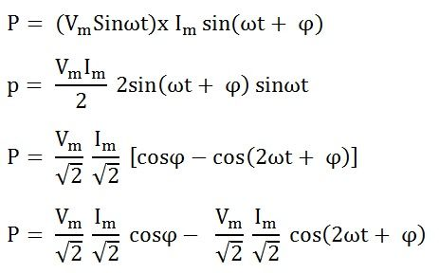
Power in RC circuit
Instantaneous power

Slide 45
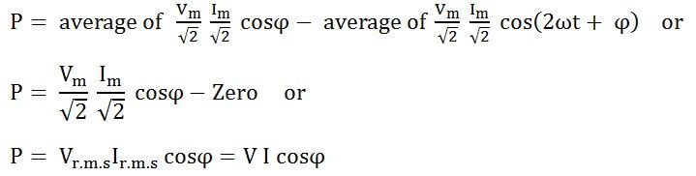

Average power and Power Factor
cosϕ is called the power factor of the circuit.

Slide 46
Power in AC circuits
Active Power: (P)- the actual power which is really transferred to the load-Real Power (Actual Power, True Power, Watt-full Power, Useful Power, Real Power, and Active Power) and denoted by (P) and measured in units of Watts (W)
Reactive Power: (Q) -energy is first stored and then released in the form of magnetic field or electrostatic field in case of inductor and capacitor respectively- unit of Reactive Power is Volt-Ampere reactive i.e. VAR

Slide 47
Power-Contd…
Apparent Power: (S)- Total power in an AC circuit, both dissipated and absorbed/returned is referred to as apparent power-measured in units of Volt-amp (VA).

Slide 48
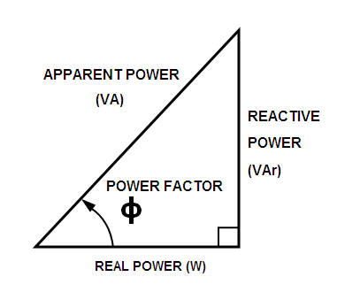
Power Triangle
VI
VI sin𝝓
VI cos𝝓

Slide 49
Problem 2
A resistance of 120 ohms and capacitive reactance of 250 ohms are connected in series across an a.c voltage source.If a current of 0.9A is flowing in the circuit, find i) power factor ii)supply voltage iii)voltage across resistance and capacitance iv)active and reactive power

Slide 50
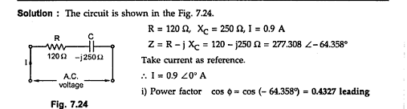

Slide 51
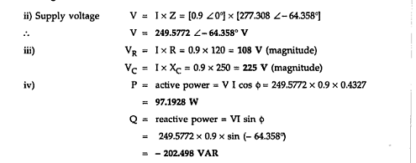

Slide 52
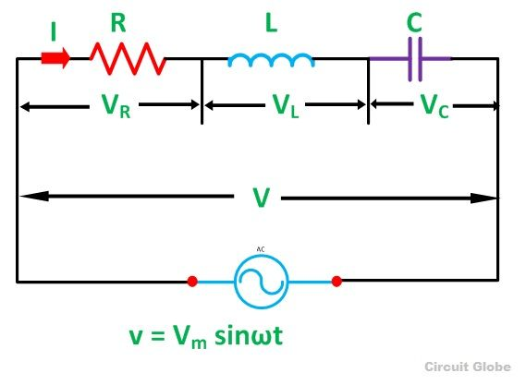
A.C in Series RLC circuit
.

Slide 53
Series RLC circuit-Contd…
V_{R} = IR that is the voltage across the resistance R and is in phase with the current I.
V_{L} = IX_{L} that is the voltage across the inductance L and it leads the current I by an angle of 90 degrees
V_{C} = IX_{C} that is the voltage across capacitor C and it lags the current I by an angle of 90 degrees.

Slide 54
Reflection spot 8
What will be the reference phasor for RLC circuit phasor diagram?
How will the phasors be aligned due to the combined effect of L&C?

Slide 55
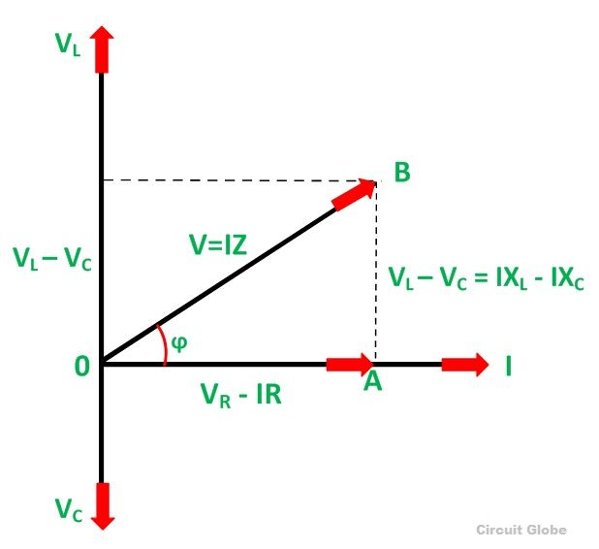
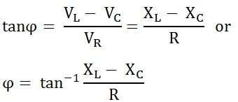
Series RLC circuit- contd…
Phase angle

Slide 56
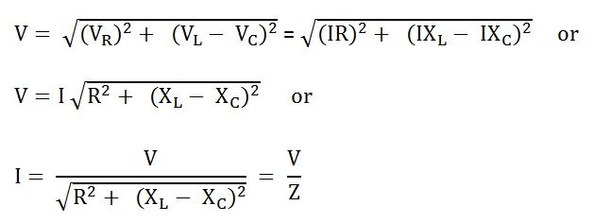

Series RLC circuit-Contd…
In complex terms: Z=R+j(x_{L}-X_{c})

Slide 57

Power in RLC circuit
When X_{L} > X_{C}, the phase angle ϕ is positive-RL series circuit -current lags behind the applied voltage -power factor is lagging.
When X_{L} < X_{C}, the phase angle ϕ is negative- series RC circuit –leading power factor.
When X_{L} = X_{C}, the phase angle ϕ is zero- the circuit behaves like a purely resistive circuit-the current and voltage are in phase with each other-power factor is unity.

Slide 58
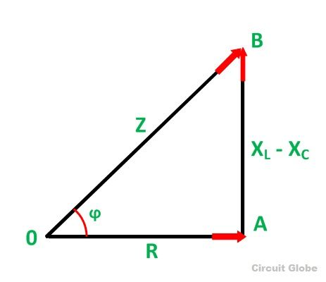
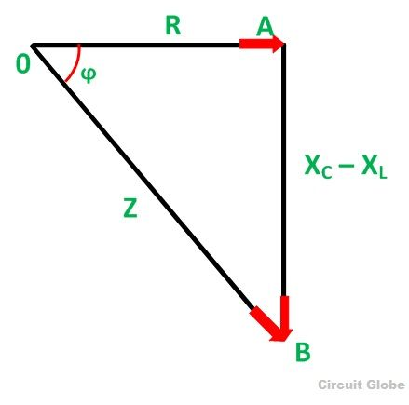
Impedance triangle-RLC circuit
(X_{L}< X_{C})
when (X_{L} > X_{C})
lagging phase angle.
Leading power factor

Slide 59
Problem 3
A series circuit having pure resistance of 40 ohms, pure inductance of 40.07 mH and a capacitor is connected across 400V , 50Hz a.c supply. This R,L,C combination draws a current of 10 A. Calculate i) power factor of the circuit and ii)capacitor value

Slide 60
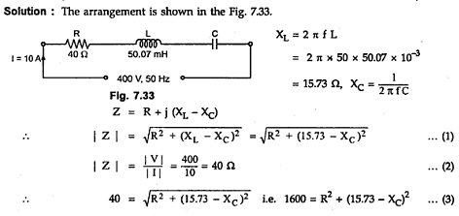

Slide 61
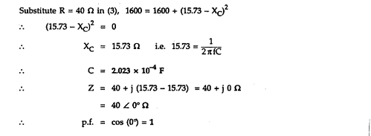

Slide 62
THANK YOU

